Slide 1




Slide 2

TEST TIME ON ODD MAN OUT
URL: https://forms.gle/pCod1vhoFzHJZLZq5
QR CODE:

Slide 3

SIMPLIFICATIONS

Slide 4
SIMPLIFICATIONS
Simplification means to find out a final answer for a complex calculation.
Basic Topics on which Simplification is based on:
BODMAS rules
Approximation
Percentage
Squares
Cubes

Slide 5
Question: Q01
A man has Rs.480 in the denominations of one-rupee notes, five-rupee notes and ten-rupee notes. The number of notes of each denomination is equal. What is the total number of notes that he has?
45
60
75
90
Answer : D

Slide 6
Explanation: Q01
Let number of notes of each denomination be x
Then x + 5x + 10x = 480
16x = 480
x = 30.
Hence, total number of notes = 3x = 90

Slide 7
Question: Q02
There are two examination rooms A and B. If 10 students are sent from A to B, then the number of students in each room is same. If 20 candidates are sent from B to A, then the number of students in A is double the number of students in B. The number of students in room A is:
20
80
100
200
Answer : C

Slide 8
Explanation: Q02
Let the number of students in rooms A and B be x and y respectively.
Then, x - 10 = y + 10
x - y = 20 .... (i)
and x + 20 = 2(y - 20)
x - 2y = -60 .... (ii)
Solving (i) and (ii) we get: x = 100 , y = 80.
The required answer A = 100.

Slide 9
Question: Q03
The price of 10 chairs is equal to that of 4 tables. The price of 15 chairs and 2 tables together is Rs. 4000. The total price of 12 chairs and 3 tables is:
Rs. 3500
Rs. 3740
Rs. 3840
Rs. 3900
Answer : D

Slide 10
Explanation: Q03
Let the cost of a chair and that of a table be Rs. x and Rs. y respectively.
Then, 10x = 4y
Y = 5/2 x
15x + 2y = 4000
15x + 2 x 5/2 x = 4000
20x = 4000
x = 200.
y= (5/2 * 200) = 500
Hence, the cost of 12 chairs and 3 tables = 12x + 3y
Rs. (2400 + 1500) = Rs. 3900.

Slide 11
Question: Q04
If a - b = 3 and a² + b² = 29, find the value of ab.
10
12
15
18
Answer : A

Slide 12
Explanation: Q04
2ab = (a² + b²) - (a - b)²
= 29 - 9 = 20
ab = 10.

Slide 13
Question: Q05
The price of 2 sarees and 4 shirts is Rs. 1600. With the same money one can buy 1 saree and 6 shirts. If one wants to buy 12 shirts, how much shall he have to pay?
1200
2400
3600
4800
Answer : B

Slide 14
Explanation: Q05
Let the price of a saree and a shirt be Rs. x and Rs. y respectively.
Then, 2x + 4y = 1600 .... (i)
and x + 6y = 1600 .... (ii)
Divide equation (i) by 2, we get the below equation.
=> x + 2y = 800. --- (iii)
Now subtract (iii) from (ii)
x + 6y = 1600 (-)
x + 2y = 800
----------------
4y = 800
----------------

Slide 15
Explanation: Q05
Therefore, y = 200.
Now apply value of y in (iii)
=> x + 2 x 200 = 800
=> x + 400 = 800
Therefore x = 400
Solving (i) and (ii) we get x = 400, y = 200
Cost of 12 shirts = Rs. (12 x 200) = Rs. 2400

Slide 16
Question: Q06
A sum of Rs. 1360 has been divided among A, B and C such that A gets ⅔ of what B gets and B gets ¼ of what C gets. B's share is:
Rs. 120
Rs. 160
Rs. 240
Rs. 300
Answer : C

Slide 17
Explanation: Q06
Let C's share = Rs. x
Then, B's share = Rs. x/4 , A's share = Rs. ( ⅔ * x/4 ) = Rs. x/6
x/4 + x/6 + x = 1360
17x/12 = 1360
X = (1360 * 12) / 17 = Rs. 960.
Hence, B's share = Rs.(960/4) = Rs. 240.

Slide 18
Question: Q07
One-third of Rahul's savings in National Savings Certificate is equal to one-half of his savings in Public Provident Fund. If he has Rs. 1,50,000 as total savings, how much has he saved in Public Provident Fund?
Rs. 30,000
Rs. 50,000
Rs. 60,000
Rs. 90,000
Answer : C

Slide 19
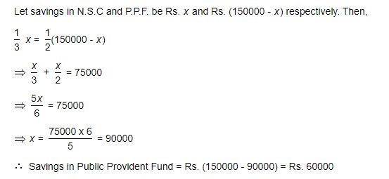
Explanation: Q07

Slide 20
Question: Q08
A fires 5 shots to B's 3 but A kills only once in 3 shots while B kills once in 2 shots. When B has missed 27 times, A has killed
30 Birds
60 Birds
72 Birds
90 Birds
Answer : A

Slide 21
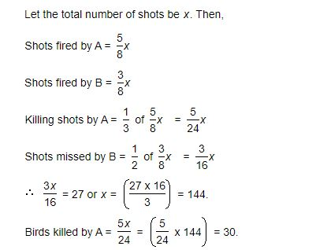
Explanation: Q08

Slide 22
Question: Q09
Eight people are planning to share equally the cost of a rental car. If one person withdraws from the arrangement and the others share equally the entire cost of the car, then the share of each of the remaining persons increased by:
1/7
6/8
1/9
7/8
Answer : A

Slide 23
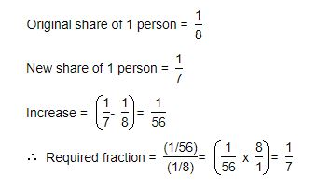
Explanation: Q09

Slide 24
Question: Q10
To fill a tank, 25 buckets of water is required. How many buckets of water will be required to fill the same tank if the capacity of the bucket is reduced to two-fifth of its present?
10
32
62.5
75
Answer : C

Slide 25
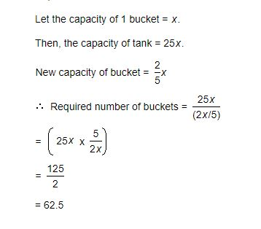
Explanation: Q10

Slide 26
Question: Q11
In a regular week, there are 5 working days and for each day, the working hours are 8. A man gets Rs. 2.40 per hour for regular work and Rs. 3.20 per hours for overtime. If he earns Rs. 432 in 4 weeks, then how many hours does he work for?
160
175
180
195
Answer : B

Slide 27
Explanation: Q11
Suppose the man works overtime for x hours.
Now, working hours in 4 weeks = (5 x 8 x 4) = 160.
160 x 2.40 + x 3.20 = 432
3.20x = 432 - 384 = 48
x = 15.
Hence, total hours of work = (160 + 15) = 175.

Slide 28
Question: Q12
Free notebooks were distributed equally among children of a class. The number of notebooks each child got was one-eighth of the number of children. Had the number of children been half, each child would have got 16 notebooks. Total how many notebooks were distributed?
256
432
512
640
Answer : C

Slide 29
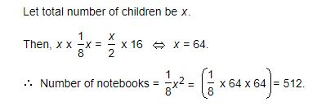
Explanation: Q12

Slide 30
Question: Q13
A man has some hens and cows. If the number of heads be 48 and the number of feet equals 140, then the number of hens will be:
22
23
24
26
Answer : D

Slide 31
Explanation: Q13
Let the number of hens be x and the number of cows be y.
Then, x + y = 48 .... (i)
and 2x + 4y = 140 x + 2y = 70 .... (ii)
Solving (i) and (ii) we get: x = 26, y = 22.
The required answer = 26.

Slide 32
Question: Q14
David gets on the elevator at the 11th floor of a building and rides up at the rate of 57 floors per minute. At the same time, Albert gets on an elevator at the 51st floor of the same building and rides down at the rate of 63 floors per minute. If they continue travelling at these rates, then at which floor will their paths cross?
19
28
30
37
Answer : C

Slide 33
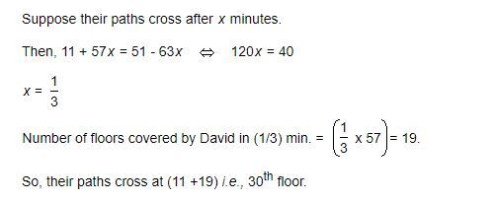
Explanation: Q14

Slide 34
Question: Q15
Solve 5(1/2) + 6(1/2) - 8(1/4)
2(3/ 4)
3((3/ 4)
2(1/ 4)
2(2/ 4)
Answer : B

Slide 35
Explanation: Q15
5(1/2) + 6(1/2) - 8(1/4) = (5+6-8) + ((1/2) + (1/2) - (1/4)) = 3(3/4)

Slide 36




THANK YOU
+91 78150 95095
codemithra@ethnus.com
www.codemithra.com

